Slide 1
MODULE II

Slide 2
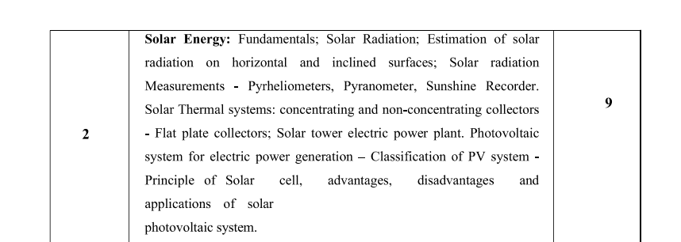

Slide 3
WHY SOLAR ENERGY
Non-conventional source of energy
Readily available
Free
Non-polluting
Solar energy received in the form of radiation, can be converted directly or indirectly into other forms of energy, such as heat and electricity.
Energy supplied by the sun in one hour is almost equal to the amount energy required by the human population in one year.

Slide 4
Draw backs of application of solar energy
1) intermittent and variable manner in which it arrives at the earth’s surface
2) large area required to collect the energy at a useful rate

Slide 5
WHAT IS SOLAR ENERGY
Originates with the thermonuclear reactions occurring in the sun.
Energy is radiated by the sun as the electromagnetic waves of which 99 percent have wavelengths in the range of 0.2 to 4.0 micrometers.
Solar energy reaching top of earth’s atmosphere consist of
8% UV radiation (short wave length , <0.39 micrometer)
46% visible light (0.39-0.78 micro meter)
46% infrared radiation (long wave length , >0.78 micrometer)

Slide 6
SOLAR CONSTANT
The rate at which Solar energy arrives at the top of the atmosphere is called the Solar Constant (Isc).
It is defined as the energy received from the sun per unit time on a unit surface area perpendicular to the sun’s direction at the mean distance of earth from the sun
The standard value National aeronautics and space administrations (NASA)-1353 watts/sq.metre.

Slide 7
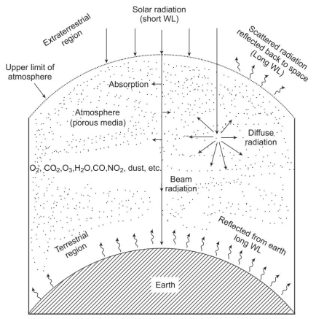
Extra-terrestrial and Terrestrial Radiations

Slide 8

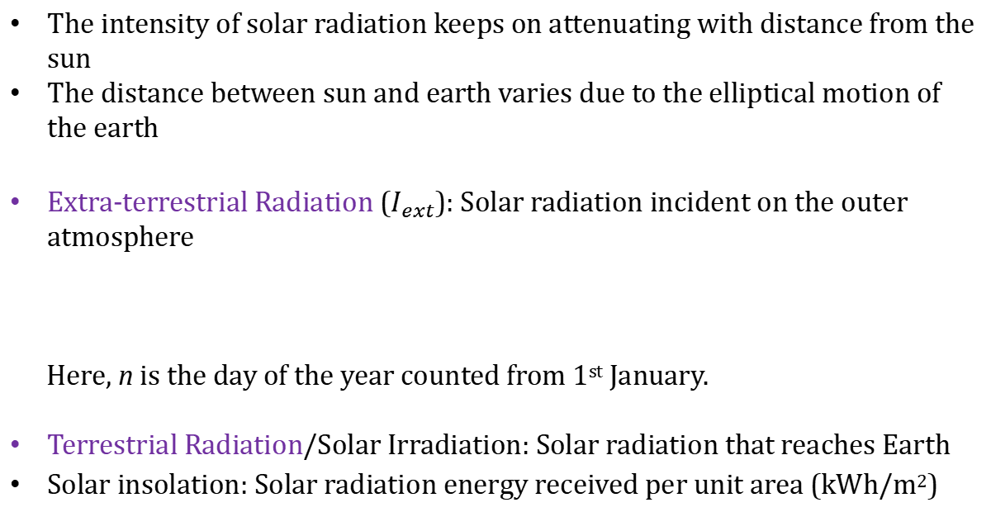
Extra-terrestrial and Terrestrial Radiations
The intensity of solar radiation keeps on attenuating with distance from the sun
The distance between sun and earth varies due to the elliptical motion of the earth
Extra-terrestrial Radiation ($I_{ext}$): Solar radiation incident on the outer atmosphere
Here, n is the day of the year counted from 1st January.
Terrestrial Radiation/Solar Irradiation: Solar radiation that reaches Earth
Solar insolation: Solar radiation energy received per unit area (kWh/m²)
$$I_{ext}=I_{sc}\left[1+0.033\cos\left(\frac{360}{365}n\right)\right]$$
W/m²

Slide 9
The extra-terrestrial(outside the earth’s atmosphere) radiation can be determined by using solar constant as follows:
Iext =Isc*(Rav/R) W/m
where
Iext is the extra-terrestrial radiation
Isc is the solar constant
Rav is the mean distance between the sun and the earth
R is the actual sun-earth distance

Slide 10
SOLAR RADIATION
In earth atmosphere, part of radiation is reflected back in to the space especially by cloud.
Radiation entering the atmosphere is partly absorbed by molecules in the air, also some part is scattered by droplets in clouds and by dust particles
Solar radiation that has not been absorbed or scattered and reaches directly from the sun is called direct radiation

Slide 11
SOLAR RADIATION
Solar Radiation = Beam Radiation + Diffuse Radiation
Beam Radiation (Direct radiation) – Reaches directly to the earth surfaces without change in direction
Diffused Radiation – Solar radiation from the sun after its direction has been changed by reflection and scattering by atmosphere
Total solar radiation received at any point on earth surface = Beam Radiation + Diffuse Radiation
Also called Insolation: Total solar radiation received on a horizontal surface of unit area(1 sq.m) on the ground in unit time (1 day).
Insolation varies with date, time, altitude of sun in the sky and with weather conditions (clouds, humidity).

Slide 12
Sun at Zenith: It is the position of sun directly overhead
Irradiance(W/m2): The rate of incident energy per unit area of a surface
Albedo: The earth reflects back 30% of the total solar radiant energy to the space by reflection from clouds, by scattering and by reflection at the earths surface. This is called the albedo of the earths atmosphere system.

Slide 13
ABSORPTION AND SCATTERING
Variation in solar radiation reaching the earth than received at the outside of the atmosphere is due to Absorption and Scattering
Absorption : Short wave Ultra-violet rays by ozone and long wave infra red by CO2 and moisture in the atmosphere.
Scattering : As Solar radiation passes through the earth’s atmosphere the components of the atmosphere, such as water vapour, dust in the atmosphere causes scattering.

Slide 14
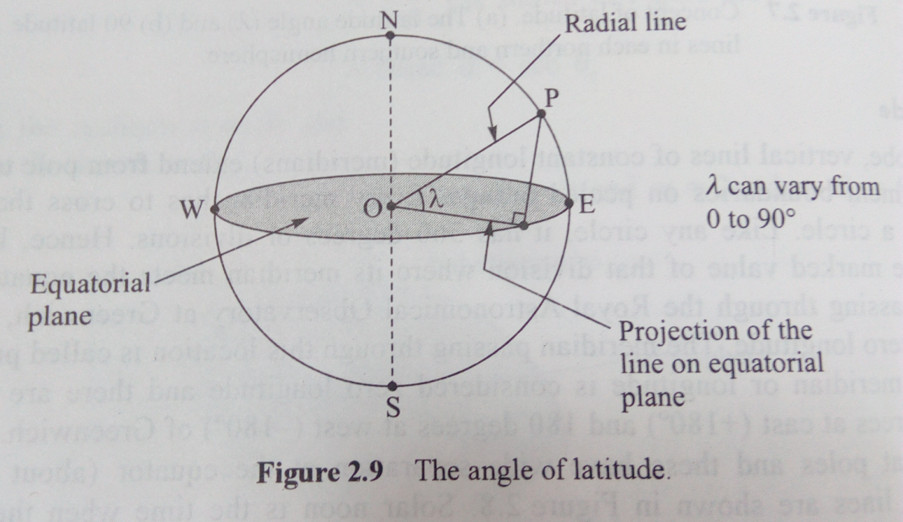
BASIC SUN EARTH ANGLES
Latitude or angle of latitude(λ)
The latitude of a location on earth’s surface is the angle made by the radial line joining the specified location to the centre of earth with the projection of this line on the equatorial plane.
The latitude at equator is zero and it is 90⁰ at poles.

Slide 15
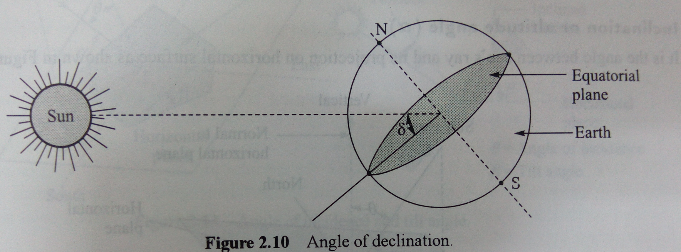
Declination angle(δ)
It is the angle made by the line joining the centres of sun and earth with the equatorial plane.
The angle of declination varies when the earth revolves around the sun.
For minimum or maximum declination the sun appears to stand still

Slide 16
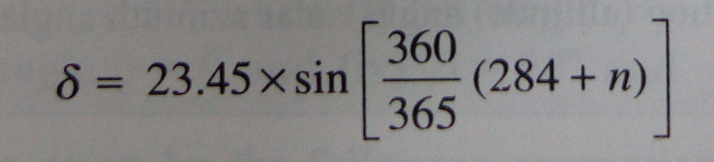
It has maximum value of 23.45⁰ when earth achieves a position in its orbit corresponding to 21 June and it has minimum value of -23.45⁰ when earth is in orbital position corresponding to 22 December.
The angle of declination is taken positive when it is measured above the equatorial plane in the northern hemisphere.
The angle of declination can be given by
where n is the number of days counted from 1 January

Slide 17
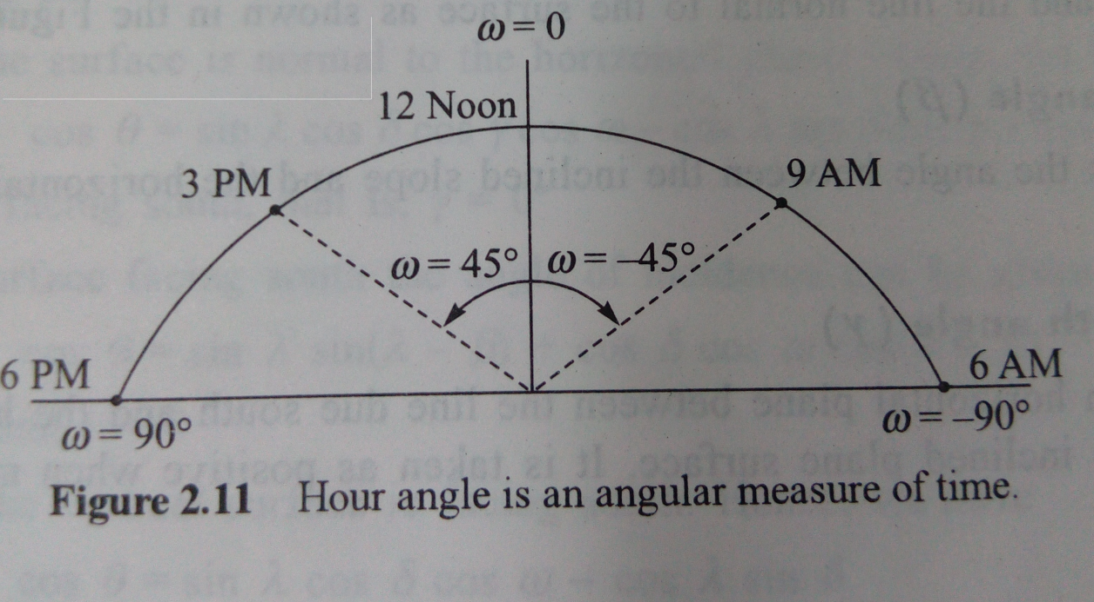
Hour angle(ω)
It is an angular measure of time at the rate of 15 degree per hour
The hour angle at any instant is the angle through which the earth has to turn to bring the meridian of a point directly in line with sun’s rays.
Hour angle is measured from Noon , based on local apparent time being positive in afternoon and negative in forenoon

Slide 18
I hour corresponds to 15⁰ of earth’s rotation.(360⁰ in 24 hour).
As at solar noon the sun rays is in line with local meridian or longitude, the hour angle at that instant is zero.
The hour angle can be given as:
ω= [solar time -12]x 15⁰

Slide 19
Calculate the hour angle at 10:30 AM local apparent time.
Solution:
ω= [solar time -12]x 15⁰
=15*(10.5-12)
=-22.5º

Slide 20
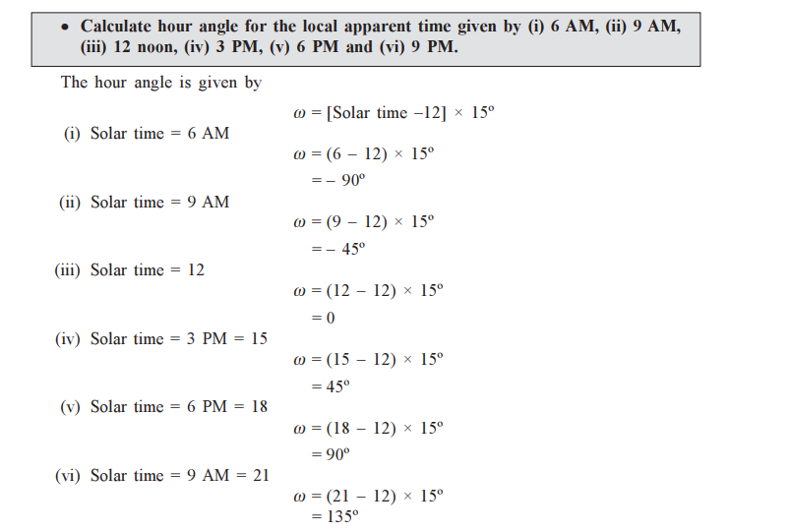

Slide 21
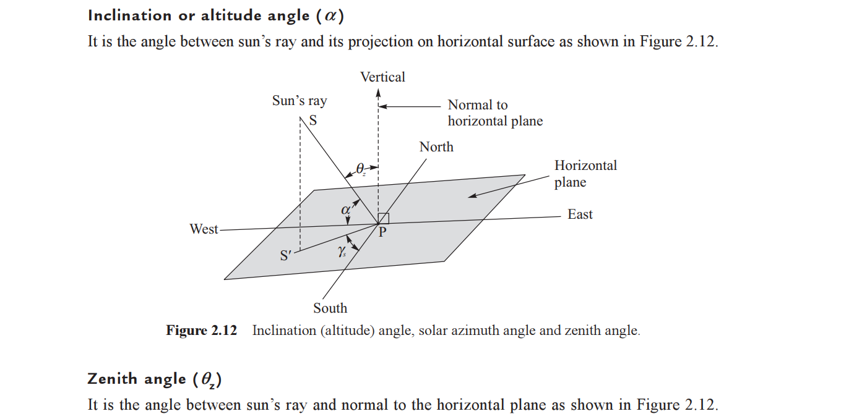

Slide 22
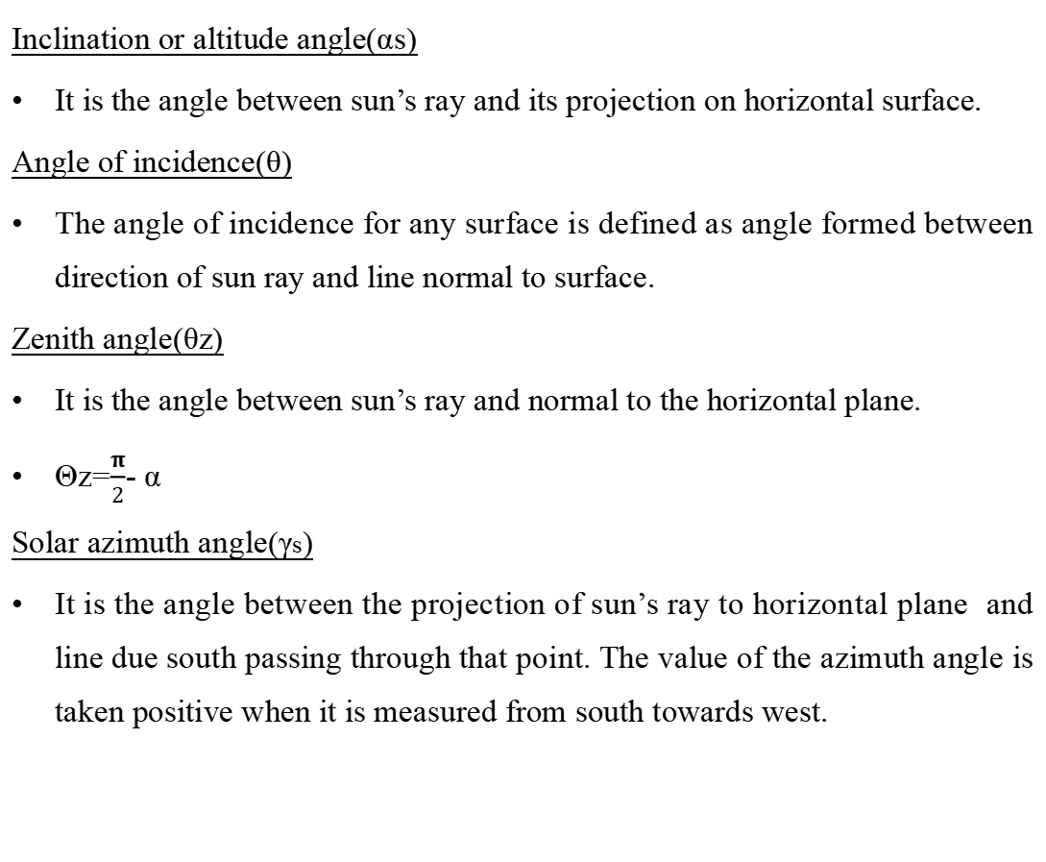
Inclination or altitude angle(αs)
It is the angle between sun’s ray and its projection on horizontal surface.
Angle of incidence(θ)
The angle of incidence for any surface is defined as angle formed between direction of sun ray and line normal to surface.
Zenith angle(θz)
It is the angle between sun’s ray and normal to the horizontal plane.
Θz=$\frac{π}{2}$- α
Solar azimuth angle(γs)
It is the angle between the projection of sun’s ray to horizontal plane and line due south passing through that point. The value of the azimuth angle is taken positive when it is measured from south towards west.

Slide 23

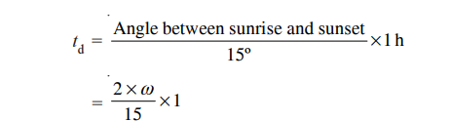
where Ф latitude angle
At sunrise and sunset θ=θz= 90 º
Cos θz = 0
Cos ω = -tanФ tanδ
The angle between sunrise and sunset or solar day length= 2ω
The sun traverses 15 º in 1hour duration. The sunshine is available between sunrise and sunset in solar day length. The duration of sunshine hours or daylight hours can be given as

Slide 24
Angle of incidence(θ)
The angle of incidence for any surface is defined as the angle formed between the direction of the sun ray and the line normal to the surface.
Tilt or slope angle(β)
The tilt angle is the angle between the inclined slope and the horizontal plane.
Surface azimuth angle(γ)
It is the angle in horizontal plane between the line due south and the horizontal projection of normal to inclined surfce.It is taken positive when it is measured from south towards west.

Slide 25
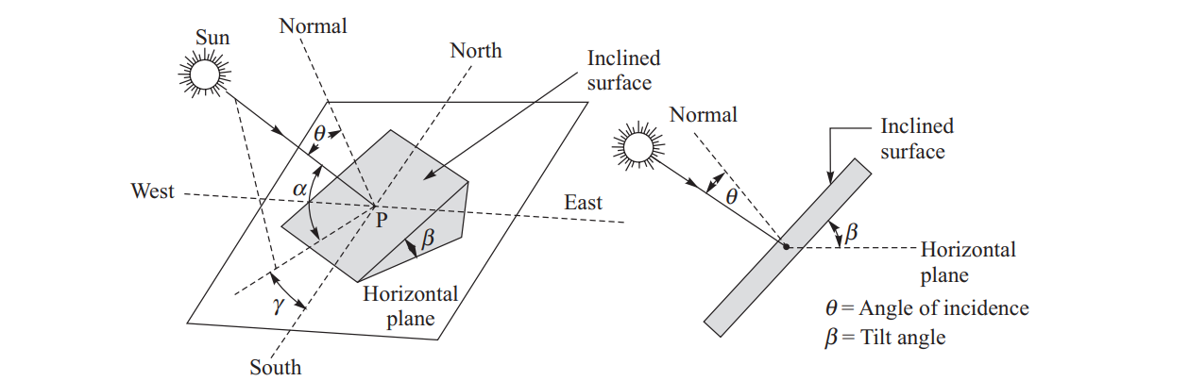

Slide 26
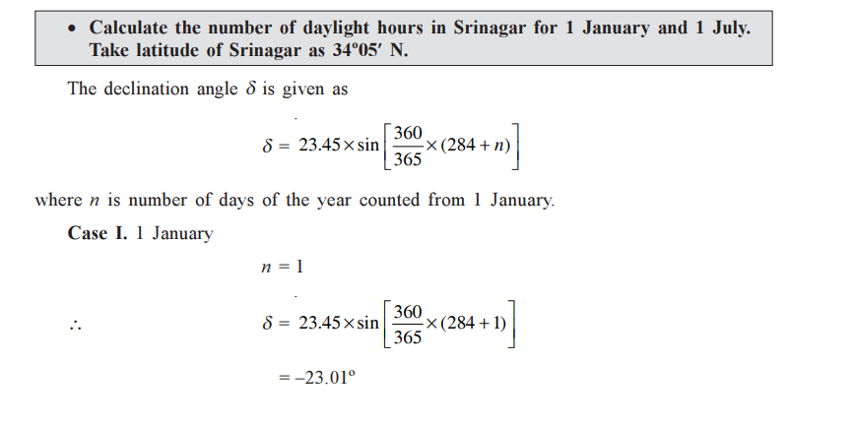

Slide 27
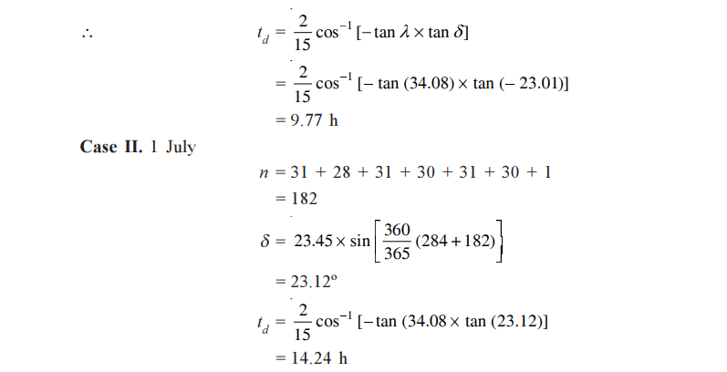
λ latitude angle

Slide 28
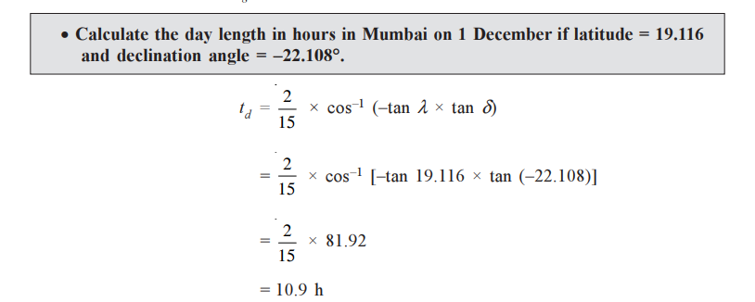

Slide 29
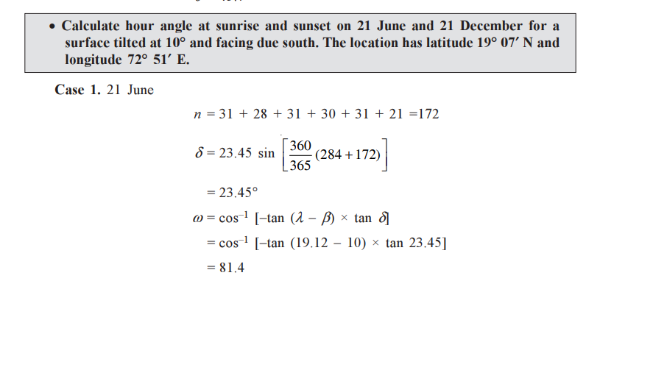

Slide 30
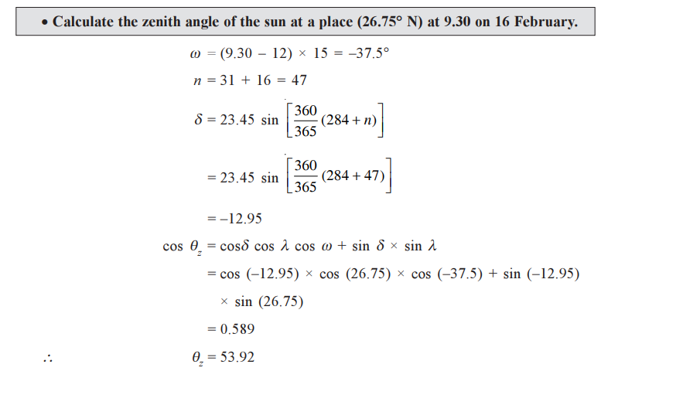

Slide 31
MEASUREMENT OF SOLAR RADIATION
Pyrheliometer-
is an instrument for measurement of direct beam solar irradiance. Sunlight enters the instrument through a window and is directed onto a thermopile which converts heat to an electrical signal that can be recorded. The signal voltage is converted via a formula to measure watts per square metre.
The sensor is a thermopile(A thermopile is basically a series arrangement of thermocouples used to develop a much greater voltage than its possible using only one.) and its disc is located at the base of a tube whose axis is aligned in the direction of sun’s rays.
It is used with a solar tracking system to keep the instrument aimed at sun

Slide 32
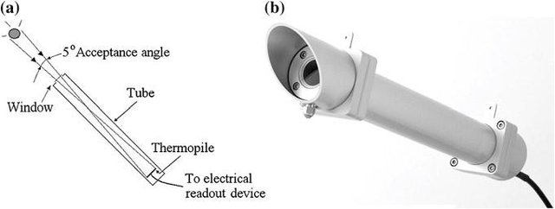

Slide 33
TYPES OF PYRHELIOMETERS
Types :
  Angstrom pyrheliometer
  Silver disc pyrheliometer
  Eppley pyrheliometer

Slide 34
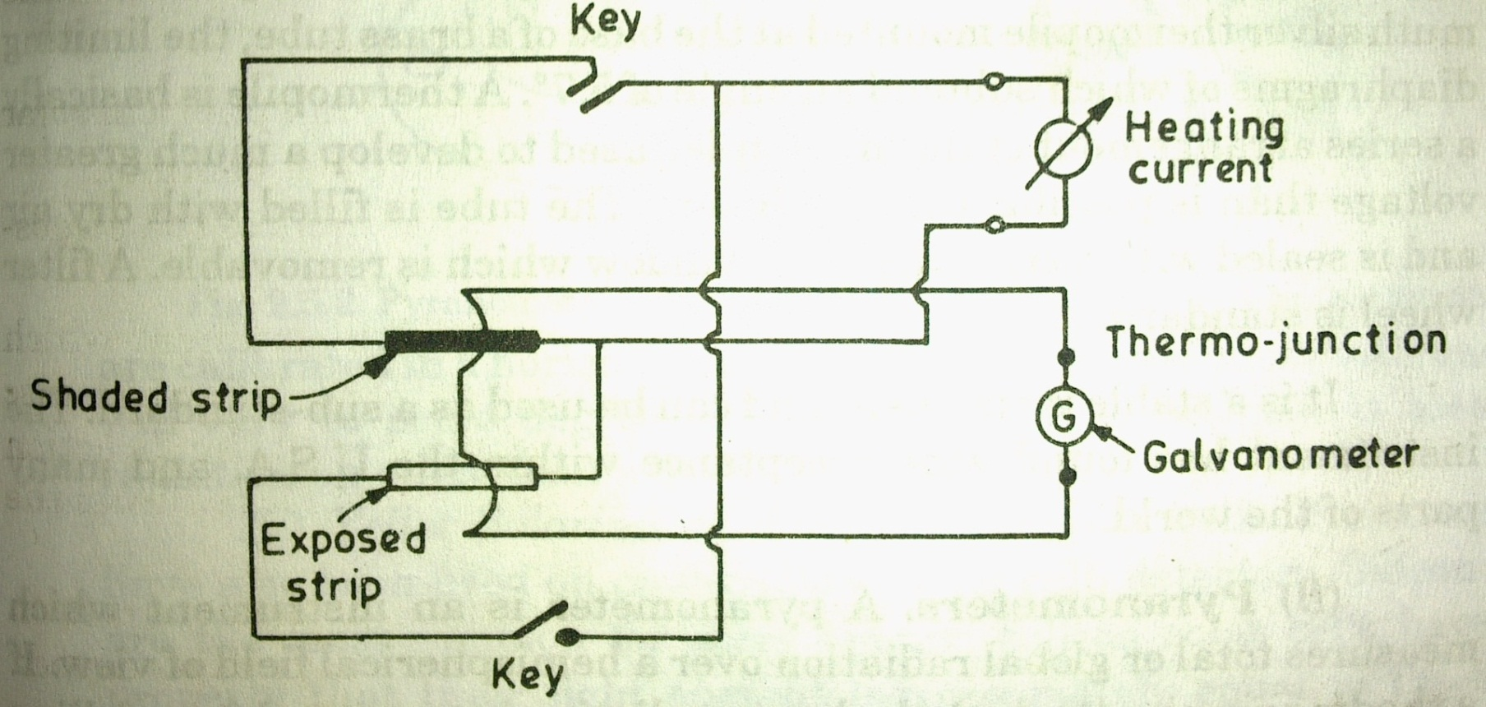
Angstrom Compensation Pyrheliometer
A thin blackened shaded manganin strip is heated electrically up to the same strip exposed to solar radiation.
The thermocouples on the back of each strip connected in opposition through a galvanometer to check the equality of temperature.

Slide 35
When solar irradiance is measured with this type of pyrheliometer, the small shutter on the front face of the cylinder shields one sensor strip from sunlight, allowing it to reach only the other sensor.
A temperature difference is therefore produced between the two sensor strips because one absorbs solar radiation and the other does not, and a thermo electromotive force proportional to this difference induces current flow through the galvanometer.
Then, a current is supplied to the cooler sensor strip (the one shaded from solar radiation) until the pointer in the galvanometer indicates zero, at which point the temperature raised by solar radiation is compensated by Joule heat.

Slide 36
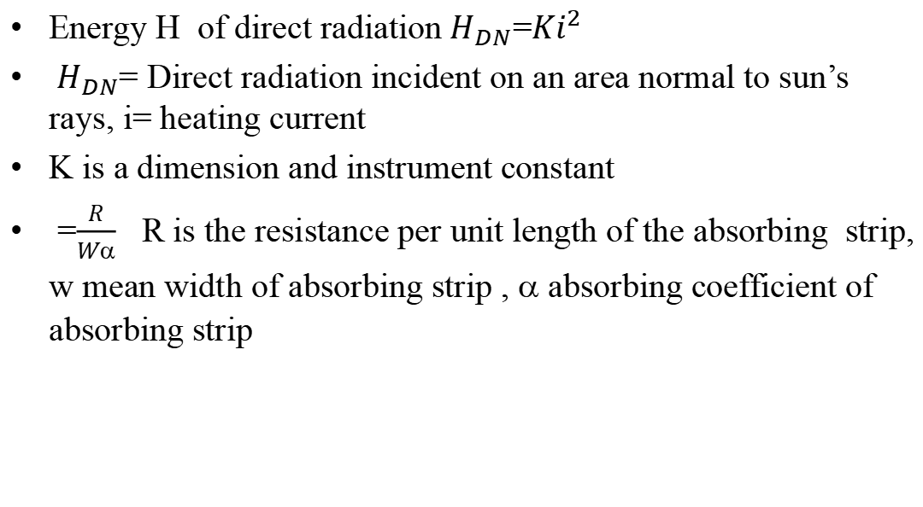
Energy H of direct radiation${ H}_{DN}$=${Ki}^{2}$
${ H}_{DN}$= Direct radiation incident on an area normal to sun’s rays, i= heating current
K is a dimension and instrument constant
=$\frac{R}{Wα}$ R is the resistance per unit length of the absorbing strip, w mean width of absorbing strip , $$ absorbing coefficient of absorbing strip

Slide 37
Silver Disk Pyrheliometer
The sensing element is a silver disk measuring 28 mm in diameter with a thickness of 7 mm that is painted black on its radiation-receiving side.
It has a hole from the periphery toward the center to allow insertion of the bulb of a high-precision mercury-in-glass thermometer.
To maintain good thermal contact between the disk and the bulb, the hole is filled with a small amount of mercury. It is enclosed outside by a heat-insulating wooden container.
The stem of the thermometer is bent in a right angle outside the wooden container and supported in a metallic protective tube.
A cylinder with diaphragms inside is fitted in the wooden container to let direct solar radiation fall onto the silver disk.
There is a metallic-plate shutter at the top end of the cylinder to block or allow the passage of solar radiation to the disk.

Slide 38
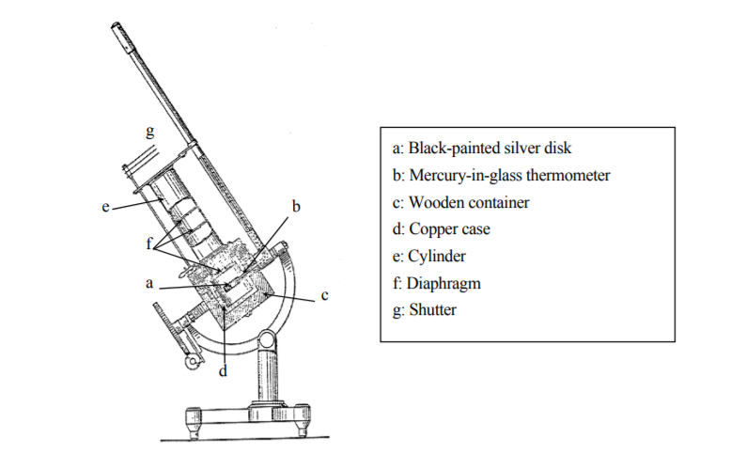

Slide 39
During the measurement phase, the disk is heated by solar radiation and its temperature rises. The intensity of this radiation is ascertained by measuring the temperature change of the disk between the measurement phase and the shading phase with the mercury-in-glass thermometer.

Slide 40
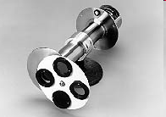
Eppley Pyrheliometer
Bismuth-silver thermopile with 15 temperature compensated junctions mounted at the base of a brass tube with a series of diaphragms.
The tube is filled with dry air and sealed with crystal quartz window which is removable.
The instrument is mounted on a motor-driven heliostat which is adjusted every week to cover changes in the sun’s declination

Slide 41
Pyrheliometer
Advantages
The advantages of the Pyrheliometer include the following.
Very low power consumption
Operates from a wide range of voltage supplies
Ruggedness
Stability
Pyrheliometer Applications
The applications of this instrument include the following.
Observations of Climate
Testing research of Material
Estimation of the solar collector’s efficiency
PV devices

Slide 42
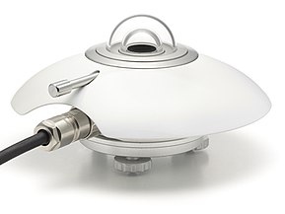
Pyranometer
A pyranometer is used for measuring solar irradiance on a planar surface

Slide 43
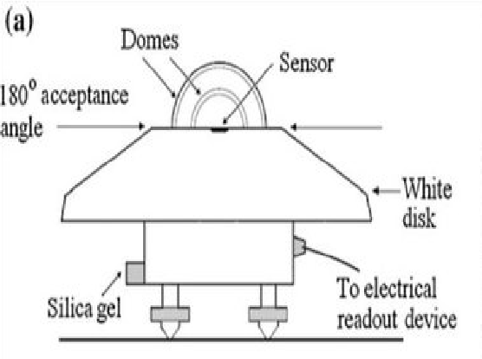
Pyranometer

Slide 44
The Acceptance angle for solar irradiance measurement is the maximum angle at which incoming sunlight can be accurately measured or captured by an instrument or solar concentrator.
The 180-degree field of view allows the instrument to capture incoming radiation from all directions above the plane of the sensor, from horizon to horizon.

Slide 45
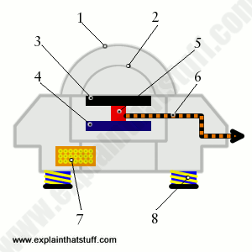
Outer dome made from a hemisphere of optical-quality glass.
Inner dome made from a smaller hemisphere of optical glass.
Black carbon disk (illuminated by the Sun) absorbs a broad range of wavelengths of solar radiation and acts as the sensing element.
Second, control disk (not illuminated by the Sun) acts as a comparison and compensating element.
Thermopile temperature sensor compares the temperature rise of the two disks.
Output lead (usually about 10m or 30ft long).
Replaceable silica gel cartridge (dessicant) absorbs moisture to prevent dew forming inside on cold nights.

Slide 46
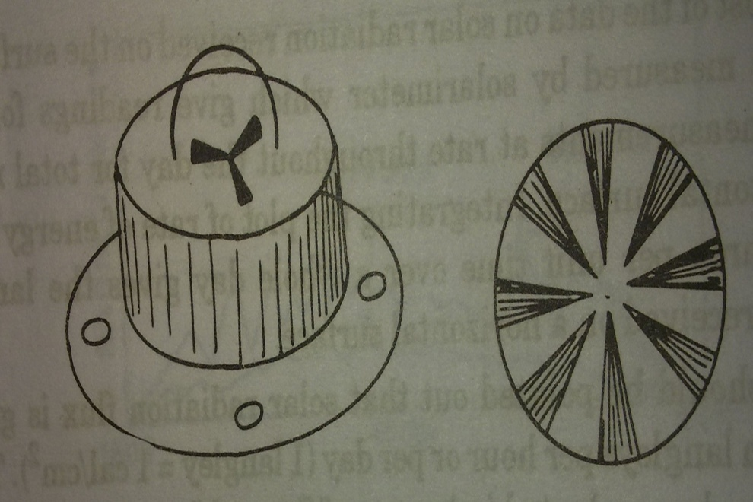
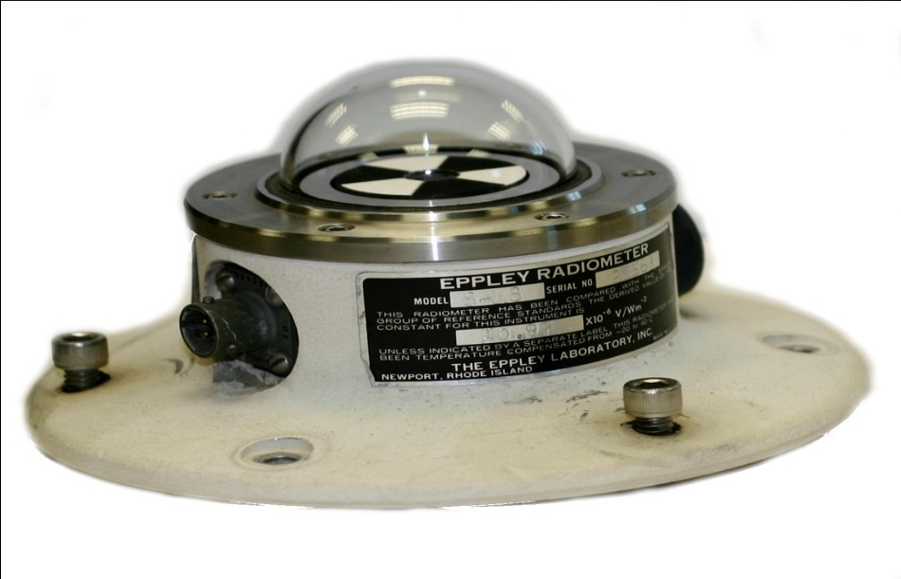
Eppley Pyranometers
It uses concentric silver rings 0.25 mm thick, appropriate coated black and white with either 10 or 50 thermo couple junctions to detect temperature differences b/w coated rings
There is a temperature difference between black surface (absorbs most solar radiation) and white surface (reflects most solar radiation). Detection of temperature difference achieved by thermopile

Slide 47
Yellot Solarimeter (Photovoltaic solar cell)
used on photovoltaic(solar cell) detectors.
Silicon cells are used to measure solar radiations.
The incident radiations on solar cells are converted to the equivalent electrical energy.

Slide 48
Advantages
The temperature coefficient is extremely small
Standardized to ISO standards
Measurements are accurate
Disadvantages
Response time is longer compared to PV cell.
The disadvantage of the pyranometer is, its spectral sensitivity is imperfect, so it does not observe the complete spectrum of the sun. So errors in measurements can occur.
Pyranometer Applications
The applications are
The solar intensity data can be measured.
Climatological & Meteorological studies
PV systems design
Locations of the greenhouse can be established.
Expecting the requirements of insulation for building structures

Slide 49
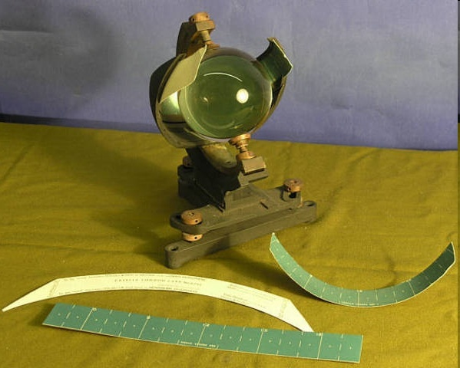
Sunshine Recorder
The duration in hours of bright sunshine in a day is measured by a sunshine recorder

Slide 50
It consists of a glass sphere installed in a section of spherical metallic bowl, having grooves for holding a recorder card strip.
The glass sphere is adjusted to focus sun rays to a point on the card strip.
On a bright sunshine day, the focused image burns a trace on the card.
Through the day the sun moves across sky, the image moves along the strip.
The length of image is a direct measure of the duration of bright sunshine.

Slide 51
Components: A glass sphere (lens) mounted in a metal bowl with slots for different cards, and a base adjustable for latitude.
Mechanism: The glass sphere acts as a lens, focusing the sun's rays onto a specific point on the card.
Recording: As the sun moves across the sky, the focused spot burns a track on the card.
Card Types: Different cards (straight, short curved, long curved) are used for different seasons, and the total hours are read from the burn length.

